Slide 2
High level understanding of track-2 activities across program phases
The activities for delivering Core Transformation in Track-2, spans the Inception Phase and the Build phase, with specific experience & expertise driving the workshops & deliverables
Program Phase
Programme Inception
Design and Build
Supports Technical & Platform expertise to Track-1
Assist with APD & Platform Product Model setup
Assist Process design with technical inputs on integrations, data, digital etc.
Guide on OOTB conformance (Config vs Custom)
Identify big ticket items and that deviate build principles
Build Integration mapping & inventory including HLAPs
Provide guidance on foundation elements, specific to integrations, BillingCenter, to drive reuse with releases
Setup Data and Test Strategies.
Enable Automation & Interoperability
Build Core based on backlog & design
Build Digital, Core (Policy / Billing / Claims) functional
Build Integrations from Core – using APIs
Integrate Digital Portal with Core
Perform Manual test on components built
Build Migration process for Renewals
Feed DW/BI from Core
Build Automation Test capabilities
Support Stabilization & Hypercare
A detailed plan for the activities and deliverables for Track-2 is depicted in next slide

Slide 3

Track-2 HIGH-LEVEL programme Inception activities
12-week accelerated plan to Define the solution for LÄNSFÖRSÄKRINGAR
01 | 02 | 03 | 04 | 05 | 06 | 07 | 08 | 09 | 10 | 11 | 12
Key Focus Areas
Rapid Solution Workshops (RSWs) with Rationalization Across Workstreams
Foundational phase that enables predictable and higher quality implementation outcome through a focus on the end-state and participation from cross-functional, empowered delivery teams
Emphasis is on gaining an understanding of the breadth of requirements at a planning/estimating level of detail
Conduct Rapid Solution Workshops (RSWs) to validate requirements for Insurance
Future State Architecture & Product Definition
ASE 1 will have a focus on the Future of Insurance and will provide the Länsförsäkringar leadership with a target state user journey and roadmap.
ASE 2 will be during the inception phase with a focus on requirement definition, road mapping and prioritization.
Track-1
Business Capabilities & Data Gathering – Build Program & Release Backlogs
Current State Process & Product Rationalization Review
GW Future State Gap Analysis – Core Processing
Track-2
Product Model Definition - APD
Technical
Support & Assist defining Future State Architecture
Integration Analysis (GW and Interoperability Layer) – HLAP Definition
Preparation & Kick Off
Conversion Strategy & Approach
Finalization & Solution Build Mobilization
Data & Downstream Integration Strategy
Key Accelerators
Test Strategy & Automation Approach
Product Backlog (Capgemini’s GW OOTB product backlog)
OOTB Process Flows
OOTB User Stories and User Stories
OOTB Field Level Specifications
OOTB Business Rules in plain English
High Level Approach and Designs key components and integrations to billing system – Document Production/Management, Financials etc
Templates for key deliverables – Estimation Models, Test Strategy, Implementation Plan etc.
Test
Test Environment & Data Management Plan
Implementation Planning 1st Cut
Review
Refine
Implementation Planning
Core
Modernization Roadmap
Operational Planning
Track-3
Devops / Code-Release Management / Environment Provisioning Planning / Security/Performance Testing Guidance
PMO
Program Management – Establish Program Governance, Operating Model, Infrastructure, Support Architecture, Program Planning
ASE = Accelerated Solutions Environment

Slide 4
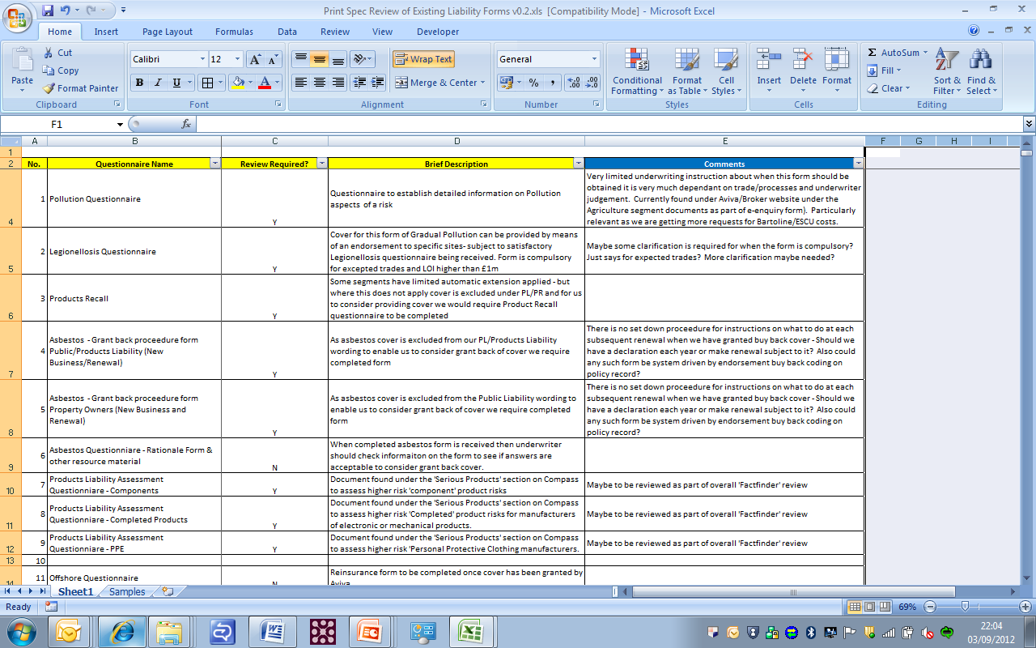
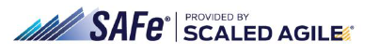
Track-2 assumes natural synergies of Track-1 deliverables to build core
Our solution approach
Key building blocks* of the platform implementation approach
Key Outputs & Deliverables
Product Design & Rationalization
As-is understanding of The organization, systems & processes support and deliver LF strategy
Vision, target states & clear understanding of gaps
Defined outputs for Product design and Target Operating Model
To-be processes
Target Business Process
Gap analysis
Process maps
Role definitions
Roadmap and summary of key implementation enablers
b
Programme Delivery
a
Platform Architecture
Build
Guidewire Code with Design
Integration Mapping, Design & Code
Code Development Package
Test
Functional Platform with Continuous Integration
Functional Automation Scripts & Execution pack
Test Design, Scenarios & Cases with Results
QA certified code base
Migrate / Data
ETL routines for Data Integration
Data Mapping between core applications and LF BI Platform
Data Mapping between Legacy policy and PolicyCenter
ETL data load
E2E reconciliation & Exception handling reports
Consistent Methodology, Value delivery
Align to existing & revamp for new
Focus on team structure, Governance
Operating Model
c
* The next set of slides details these building blocks on how Capgemini will deliver Core to Länsförsäkringar
Key Activities
Build
Understand requirements
Define optimal solution Design
Adapt best practices
Develop for Design
Integrate seamlessly
Unit test, validate and promote
Test
Create, Execute Test Scripts
Functional & Service layer tests
Test migration components
End-to-End validations
Build once and reuse framework
Automated regressions
Platform Requirements
Backlogs
Field Specifications
Business Rules Catalogue
Process Flow Designs
Rating Rules
Migrate
Data Profiling and Quality Assessment
Data mapping, Data enrichment
Load legacy data into PolicyCenter
End to End to reconciliation, Exception handling
Dry run data load
Others
..
Program Estimates
Sprint Plan
HLAP
Data & Test Strategy

Slide 5
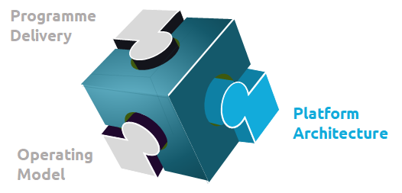
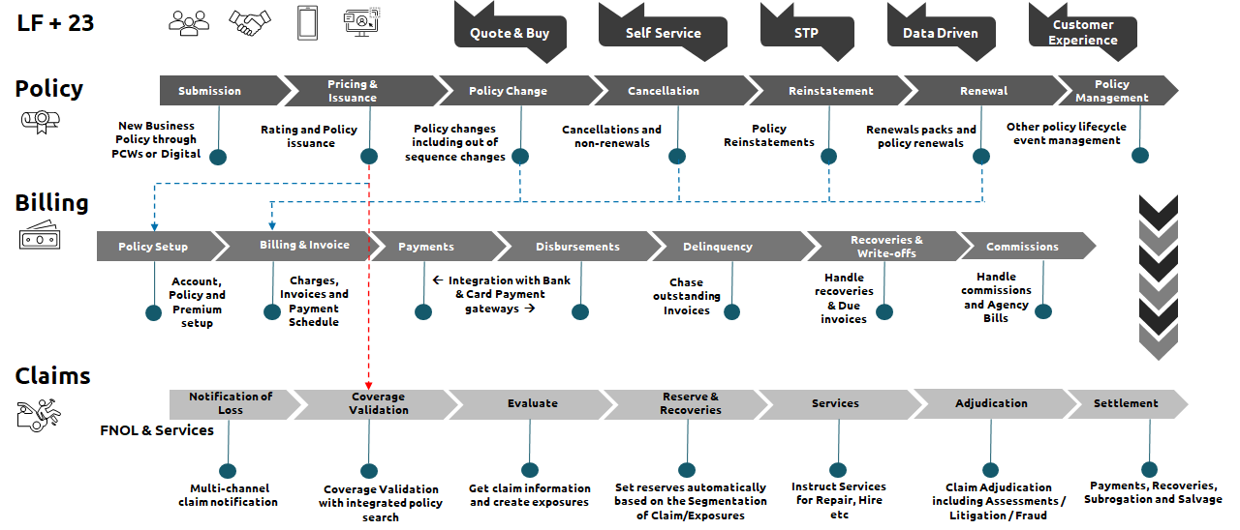







Our Track-2 solution BUILDS your ambition and customer journeys through a series of interconnected capabilities
a
Each tenet of the solution is separate but intrinsically linked; they work together to provide a unified view of the customer, automate & advise on the next best action & create a seamless omni-channel customer journey across the customer lifecycle
Business Outcomes
Digital Excellence
Heightened Customer Interactions
Pricing leadership
Agility
Automation
Realtime, Intelligent decisions
Speed to market
Personalisation
Optimisation
Innovation
Architecture Principles
Interoperability
Lightweight / Open source
Scalable / Extensible
Performant
Being Cloud Ready
Continuous Delivery
Automated Testing
Data Driven

Slide 6
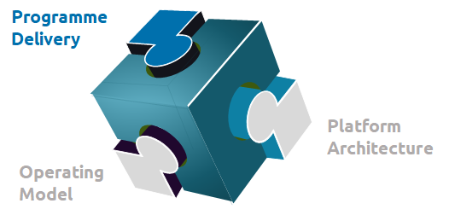





Programme Inception phase helps create the foundation & vision of the Transformation
b
A common 12-weeks Programme Inception phase to clarify and align the scope in all Products for a Foundation,
followed by the implementation of the planned Releases.
Programme Inception
Design and Build
Programme Discovery is focused on “Designing the next winning proposition”
MVP Mobilization is focused on enabling MVP Design and Build to start
Build the foundation with core principles intact. – data/ automation / experience
Collaborative pre-work on entry criteria to ensure rapid start and timely completion
Transform the plan from the Discovery to reality, transforming the business requirements to functional systems
Plan for future Releases and LOB
Roll-out Approach
What you’ll get:
Validated customer proposition
Fresh customer journeys
New High-level capabilities identified
Iterated operating model
Technology Roadmap & Plan
Everything in place for starting Inception

Slide 7
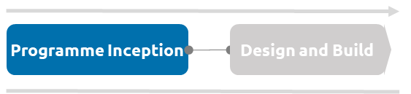



Inception for Track-2 – Is to align the TECHNICAL solution to Business and defining the backlog for LF mapped to Business objectives
b
Move to Design/Build
Facilitated Workshops by Track-1
Setup Principles
LF SME’s
CG Track-1 Team
Leadership
Platform Team
enabling empowered business users to quickly and collaboratively define, make decisions and gain alignment.
Sprints
Right Time
  Multi-day sessions
  Workshops for specific phases of the program
Sprints
Localised understanding of requirements
Sprints
Outputs
Finalised Requirements
Future State Process Flows
Procedural Change Considerations
Solution for requirements
Requirements Prioritisation/Rationalisation
Common Layer Identified
Technical Design / HLAP
Pebbles / Rocks / Boulders
- Categorizing elements of solution for appropriate escalation to finalise scope from eyes of cost of implementations
Right Inputs
  Product / Process Design
  OOTB Product Backlog
  OOTB Guidewire Process Flows
  Interfaces
Technical Team
CG Track-2 Team
Project Team
CG Track-3 Team
Right Enablers
  Guidewire Instance
  Multi-Screen Display
  Collab Tools (like Miro)
  C.A.R.B Requirements Tool
Regroup with a better understanding & summarize
Program Principles
OOTB Conformance
Business Priority / Rationale
Design for Future

Slide 8
“Adopt vs. Adapt” is the Key Principle for a successful implementation of Guidewire Platform for Länsförsäkringar to meet Business Objectives
b
Avoid complex configurations and developments for all round success:
For Länsförsäkringar: Ensure fast, low-cost implementations based on the standardization and reuse principles of the Guidewire standard features.
For Capgemini: Rapid start of the project and comply with the requirements of Länsförsäkringar in terms of planning, scope, budget, maintainability
The combined Länsförsäkringar, Guidewire and Capgemini team to bring both business and functional expertise to design an effective solution aligned with Guidewire standards throughout the scoping phase:
Always start in accordance with Guidewire Out-of-the-Box features to develop the solution
Run workshops focused on maximizing the use of the standard solution by aligning business users about process modification and change requests
Implement an arbitrage process based on the contribution of business value through a design authority mandated to arbitrate the acceptance of the configuration needs
The prioritization of the Backlog should be done according to the business value
Budget Constraints
Issues, priorities and business guidelines
IT issues and priorities
Gap
Analysis
Business Requirements
Standard Solution
Arbitrage
Solution
The implementation approach is based on the Guidewire’s solution for Länsförsäkringar combined with an efficient arbitration process to remain in 85-90% conformance levels and hence a controlled development cost & predictable timeline to deliver
© Capgemini 2020. All rights reserved |
8

Slide 9


As Inception Progresses, an end to end view of end-state is critical
Inception lays the foundation for a more predictable and higher quality implementation outcome through a focus on the end-state and participation from cross-functional, empowered delivery teams
Inputs to inception
Requirement Workshops
Customer Journey
Business Process Flow
Capgemini Accelerator
Guidewire OOTB
OOTB Process Flow
Inception
Functional Scope
Initial view of this comes from Discovery
Guiding Principles
Business & IT Architecture
1
3
Base Functionality
Integration Strategy
Programme Direction
Packaged Product Scope
Modified Functionality
Data Migration Strategy
Interfaces
Test Strategy
Data Migration
MI/BI Strategy
MI/BI
Programme Scope
Release Scope
2
4
Modified Functionality
Deployment Approach
Implementation Roadmap
Satellite Application Scope
Integration
Line of Business Sequence
Product
Backlog
Data Migration
Implementation Plan
MI/BI

Slide 10
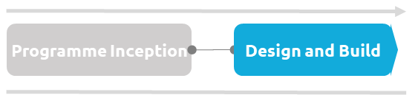


















Deliver project as Hybrid SAFe agile for Platform Implementation build, test early, test often & early business testing (EBT)
b
The approach focuses on Speed to Market and Agility to drive Business Outcomes early.
Inception
Design, Build and Test (Sprint Agile)
Stabilization
SIT, Pre-UAT,UAT & Deploy
Hyper care
Build
QA
Evaluate
Plan
Design
Build
QA
Evaluate
Plan
Design
Build
QA
Evaluate
Plan
Design
Build
QA
Evaluate
Plan
Design
Build
QA
Evaluate
Plan
Design
Build
QA
Evaluate
Plan
Design
Product Backlog
Sprint1
Sprint2
Sprint3
Sprint4
Sprint6
Build
QA
Evaluate
Plan
Design
Prep. Release
Sprint9
Sprint n..
Sprint7
Sprint8
User Stories
Acceptance
Increment
Potentially Shippable
EBT
Deploy
Fix
EBT
Deploy
Fix
EBT
Deploy
Fix
Production Release
Estimates
Deploy
SIT
SIT Environment
Sprint Plan
Fix
Potentially Releasable & Well Integrated
Pre-UAT Environment
Deploy
Pre-UAT
Update Task
Management tool
Fix
UAT Environment
Deploy
UAT
Fix
Key Results
User stories for
OOTB Functionalities
The software is developed at each sprint; tested and usable components are delivered. Review Conformance.
App. Access
Validation
Hypercare support (incident analysis, correction and testing)
Pre-SIT
SIT
Build automation (Sprint N and N-1) scripting to ensure Continuous regression
Release Preparation
High level
Integration Design
Defect Fix
Security Testing
Early and continuous acceptance of the delivered software through Pre-SIT, Pre-UAT
Transition to the Support team
Work loaded in
task management tool
Support
Pre-UAT
User Acceptance
Testing
Internal Knowledge Sharing & Retrospection
Our methodology accelerates the start of large implementations through the reuse of templates, assets and accelerators,
obtained from experience of core insurance implementations at the global level.
Note: Some of the phases, activities will be performed by LF and other tracks

Slide 11


A mixed approach to the build phase between Platform Configuration & Integration tracks…
b
Agile on configuration, to limit tunneling effect, and iterative cycle for integration
Agile on Configuration
Functionalities
Priorities
  More flexibility in taking business needs into account throughout the project
  Increased visibility on the different iterations by all parties involved
  Continuous quality control on delivered features, thus limiting the tunnel effect
High Priority
The perimeter of the next sprints is built on the basis of the most priority elements
Arbitration Process
US high detailed
Product Backlog
Add new US according to their priorities
Product Backlog
Arbitration
’impact
Analysis
Validation
Priorization
Re-prioritize Product Backlog items at any time
US simply detailed
Delete items from the Product Backlog at any time to maintain project and workload consistency
Low Priority
Configuration & Integration streams collaborate during PI & Sprint Planning to deliver to Sprint timelines
  Integration delivery spans multiple sprints
  Design the development and qualification of integration points from the start of the project
  Reliable end-to-end assembly phases by anticipating the phases of integration into the new ecosystem
  Identification of risks, definition of mitigation plans
Requirements analysis
Maintenance
V Cycle
Requirements specifications
Validation tests
System Architecture
Integration tests
Detailed Design
Unit tests
Realization
Iterative cycle for integration
© Capgemini 2020. All rights reserved |
11

Slide 12

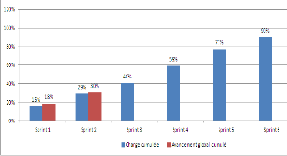
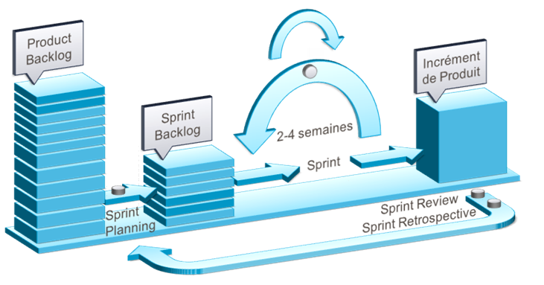
Overview Stream Configuration
b
Objectives
Team
Adopt as much as possible the Guidewire Suite to meet Länsförsäkringar specificities.
Use the standard as much as possible, in order to facilitate the evolution towards future versions of the software package.
Facilitate workshops in " Agile " mode
Organizing the appropriation of Länsförsäkringar knowledge to the use of Guidewire
Business Analysts
Architect
GW Configurators
Experts Guidewire
Activities
Contribution
Ensure to get acquainted with the existing system and carry out the minimum configuration on the basis of it before the workshops.
Leading the Business Needs and Configuration workshops with Länsförsäkringar knowledge
Configuring and unit testing screens, business rules, work plans, etc. defined during the workshops.
Business Analysts Track-1
Expert Business Länsförsäkringar
Illustration
Deliverables
List of functionalities (Monthly update of the configured functionalities, Actual and forecasted progress rate of the functionalities, Follow-up of the construction site: Decisions and pending items, Action plan for the upcoming workshops, etc.).
Business Rule Referential (description of configured business rules: entry point for future maintenance)
Sprint End Report (Sprint Content, Progress and explanation of the Non-Realized, Sprint Teachings)
Sprint progress charts
Solution: "ready-to-test" version delivered at the end of each Sprint

Slide 13

Overview Stream Integration
b
Objectives
Objectives
Team
    Design and build the Guidewire half interfaces according to the inventory and patterns defined by the Architecture department.
    Interface development
    Lead internal integration work on the development platform
    Architects
    Developers
    Guidewire SME’s
    DevOps
Activities
Activities
Contribution
    Facilitate workshops for the drafting of the Interfaces documents
    Write the functional and technical specifications of the interfaces (Interface contract, formats)
    Data Mapping between Portal ’s, Third Party /Vendor and Guidewire Suite
    Develop and test of the interfaces
    Scheduling the batches related with interfaces
    Present the design solutions to Architecture Review Board for their approval.
    Architect Länsförsäkringar IT
    Experts Länsförsäkringar (Group)
Illustration
CORE
Länsförsäkringar
Requirements analysis
Maintenance
½ interface
½ interface
V Cycle
Deliverables
Requirements specifications
Validation tests
    Interface Catalogue
    Target Application Mapping
    Correspondence table between flows and fields
    Interface software components (1/2 interface)
    Detail Design Documents and HLAP's
System Architecture
Integration tests
Detailed Design
Unit tests
Realization

Slide 14





Risk and Success Factors from our Experience
b
Risks
Success Factors
Unclear to-be processes & Journeys
Undefined Product Model
Superficial requirements with no details
Resistance to Change & reimplement legacy
Trace journey/capability/requirements
Build Product Model Early
Elicit requirements to depth
Conformance & OOTB must be the mantra
Inception
Lack of clarity and availability of Integration Mapping, Service contract & Middleware
Building for now
Missed Impact of Data on Core
External dependencies & parallel programs
Inception should focus on HLAP / HLD
Keep future releases in mind for every decision
Demarcation stream needs to be managed via an independent lead from Customer team
Architecture
No Single source of truth & understanding
Rating, Forms & GL/Financial Validation
Traceability of Scope to Test to Sign-off
Lack of Clear Test/Automation approach
Define Clear DoD for Sprints & Releases
Clear approach for Rating, Forms & GL/Financial scope.
Investment in tools to manage scope delivery
Shift-left the testing cycle & empower
Scope
Mis-understanding of “Agile”
Not managing delivery to Business objectives
Environment Provisioning & Log availability
Balancing Self-sufficient & Program goals
Setup Principles and Guard-rails to get to higher Program Agile maturity
Setup Customer BAU team & integrate with Build team
Effective Governance & Escalation management
Disciplined Change Control process
Delivery Approach
Lack of Decision Makers or Revisit decisions
Availability of Customer’s SMEs for program
Seeing Escalations as “noise”
Customer to working with offshore at scale
Create and Agree on RACI – Decision Makers
Set means of communications across teams / shores & over-communicate across program
Track issues/escalations to closure to left of program timeline to build pace
Ways of Working
Capgemini will be a partner and work closely with Länsförsäkringar to bring its experience to identify issues & mitigate risks to make the Program successful.

Slide 15
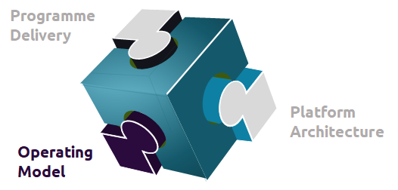

One team with parallel focus areas
c
Led by Länsförsäkringar, we’ll form one team with specialist skills working in parallel
Vision definition
Operating model design
Journey design
Tech leadership
Proposition design
Product and content design
Business change
Team mentality and culture
Use our launch pads
You’ve done lots of the work already. We’ll use this as our launchpad throughout
Customer obsessed
We’ll put the customer at the heart of everything
Constantly validating and iterating
We’ll look to learn and test early and often
Journey based design
Everything starts with a customer journey (including the Operating Model)

Slide 16


A lean governance structure to support delivery
c
A Governance structure including members of LFAB, Capgemini and Platform Vendor is proposed to review, monitor and manage the program
Governance
Activities
Innovation Planning
Reviews & Prioritization
Overall delivery oversight
Budget approvals
Dashboard (KPI) Reviews
Resolution of Escalations
Strategic
Program Sponsor
Business & IT Executives
Account Executive
Delivery Executive
Client Partner
Monthly
Steering Committee
Manage Risk/Issues & impact
Review Performance
Capacity Management
Relationship Management
Prioritization
Change Control Board
Tactical
Program Management
Architects
Business Owners
Delivery Lead
Program Management
SME & Architects
SME and Architects
Program Management
Weekly
Operational
Business Leads
IT Managers/work stream leads
Test Manager
SME/Architects
Development Lead
Technical leads
Test leads
BAs
Developers
SME & Architect
Release and Project level Reporting
Execution (day-to-day work)
Resolve operational issues
Trigger operational improvement actions
Review Weekly Status
Program Delivery
Daily
01
02
03
04
Make work visible
Trust our teams
Remove friction
Learn with feedback

Slide 17

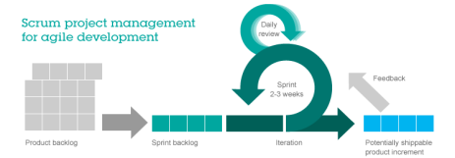

An One-team that also comes together in a Structure to Deliver
c
  Capgemini team will be aligned with LFAB’s team to shared knowledge of critical business and technology issues.
  Offshore team is a critical component to deliver the program at scale & speed
Executive Leadership
Capgemini Exec Sponsor
Steering Committee
Executive Sponsors
Platform
Sponsor
Program Leadership
PMO
Programme Manager
* Programme
Manager
Architects
Product Owner(s)
Tech Arch & Product SME
PMO
Delivery Teams
* Functional Lead / * Process Leads / * Product Leads / * Business Leads
# Configuration Lead
# Integration Lead
# Portal Lead
# Data Lead
# Test Manager
Infra Lead
^ Devops Lead
* OCM Lead
Test Lead
Test Lead
Leaders ensure alignment between Workstream
# Policy
# Claims
# Billing
# Integration
# Portal
#Data
# Test Leads
UAT
^ Release Manager
Scrum Master
Product Owner
Business SMEs
* Business Analysts
# Dev Lead
* Business Analyst
# Tech Lead
# Developers
# Testers
Scrum Master
Product Owner
Business SMEs
* Business Analysts
# Dev Lead
* Business Analyst
# Tech Lead
# Developers
# Testers
Scrum Master
Product Owner
Business SMEs
* Business Analysts
# Tech Lead
# Developers
# Testers
# Technical SMEs
# Integration Dev
# Mapping Analyst
# Tech Lead
# Developers
# Testers
Product Owner
# Developers
# Testers
Scrum Master
Data Architect
Product Owner
# Technical SMEs
# Data Analyst
# ETL Developers
# Reporting Developers
# Testers
^ Perf & Security Testers
# Offshore Delivery Lead
# Test Lead
LEGEND
LFAB
Platform
Guidewire
Workstreams
* Track-1
# Track-2
^ Track-3
Capgemini
# Automation Testers

Slide 18
Our India team will progressively take part to the program and increase the involvement level… (Indicative – to be refined at Inception)
c
Architecture
Business priorities analysis
Roadmap scope and planning
Environment setup
Release pipeline
As is & to be architecture
transformation roadmap
Fully automated &
Integrated release
pipeline & install
Migration strategy
Build & Test
Technical Specs
Functional Specs
ETE/Integration Tests
NFR Tests
UAT support
Production rollout
Run support (not in scope)
Tests & sign off
Zero downtime Production Rollout
Knowledge transfer
& change
Sweden team tasks
Indian team tasks
Tasks shifted progressively from Sweden to Indian team
Local Sweden Team
India Team
Note: Some areas of scope will have LF at lead and will need Capgemini to support, and the detailed RACI will be defined at Inception to have right owners & focus

